Slide 1


DEEP LEARNING FOR COMPUTER VISION
Week7
Dr. Tuchsanai. PloySuwan

Slide 2
Autoencoders

Slide 3
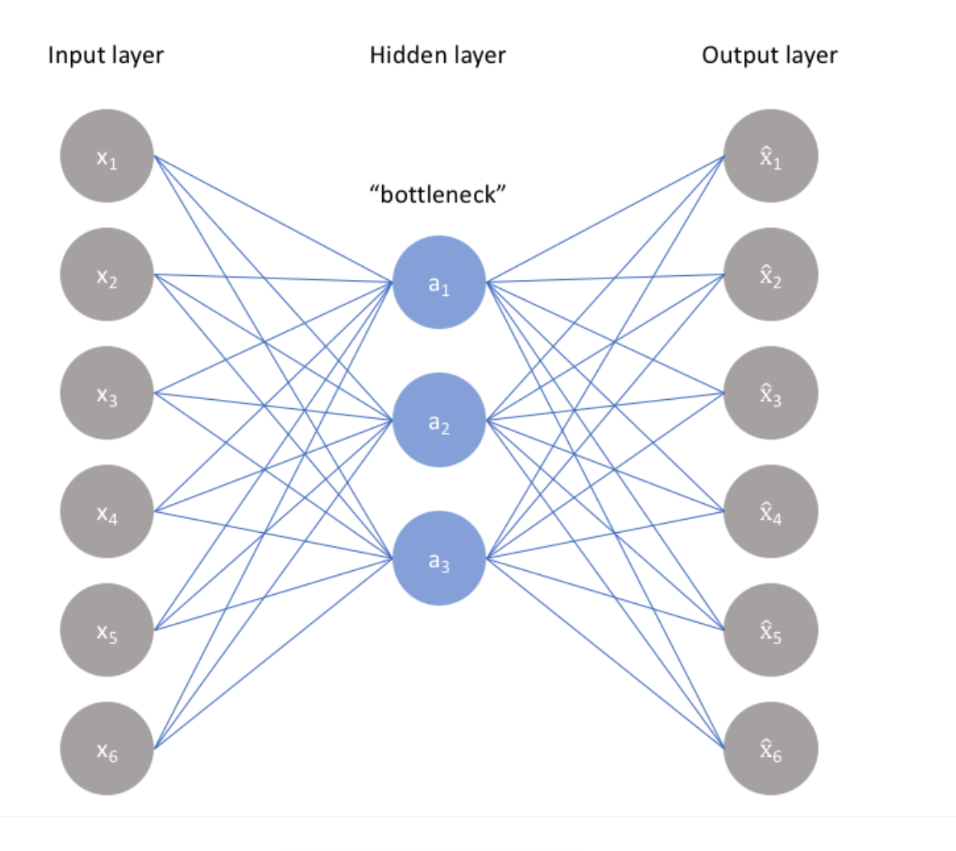

Slide 4
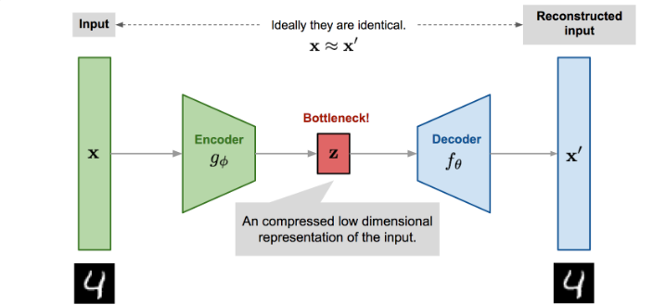
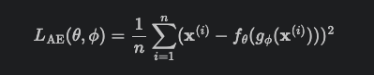

Slide 5
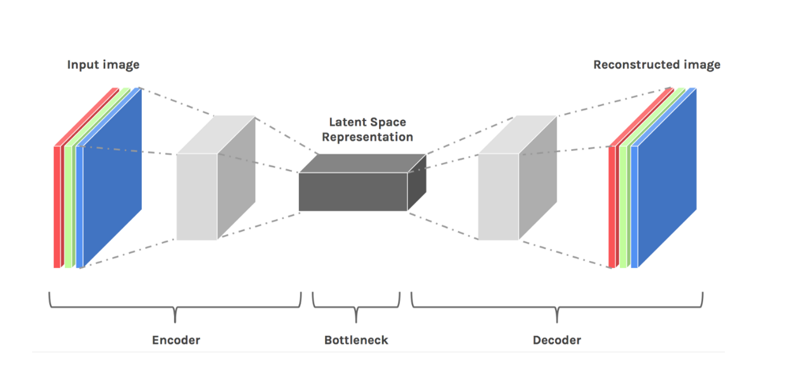
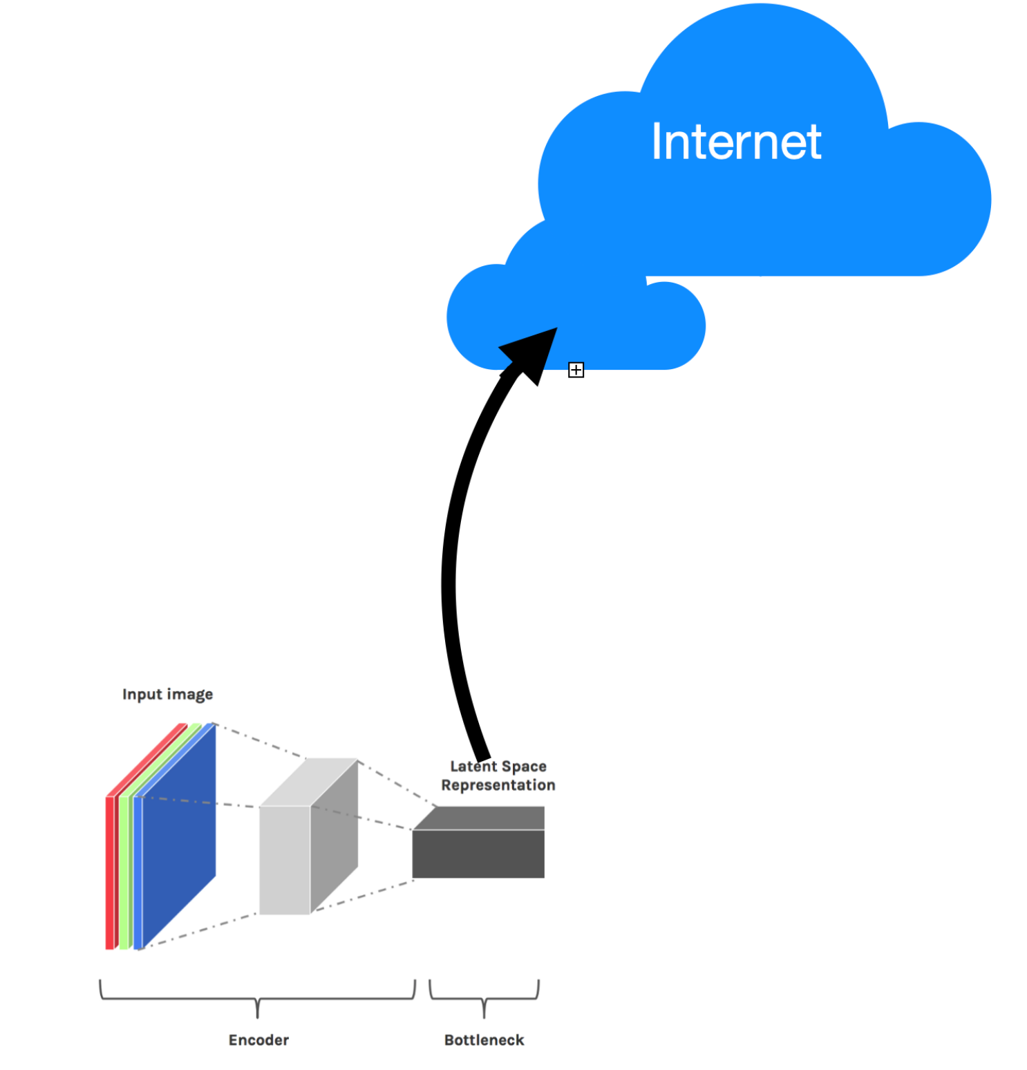
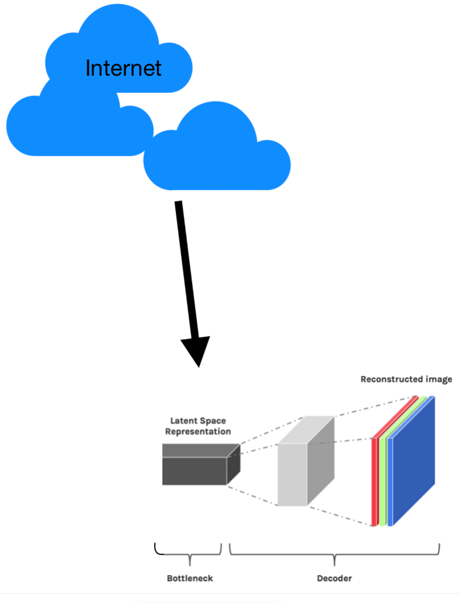
Data compression

Slide 6
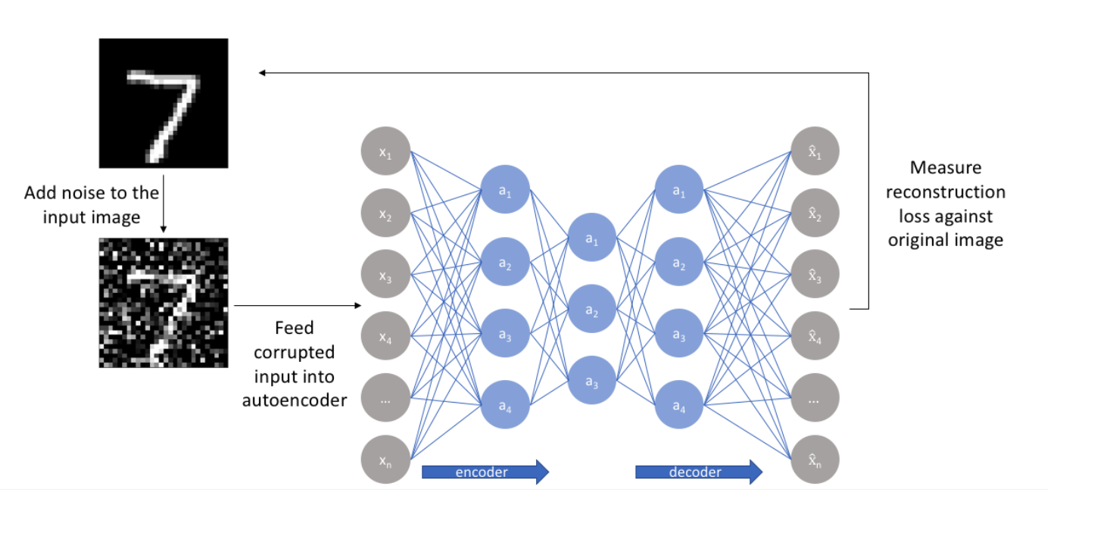
Denoising data

Slide 7
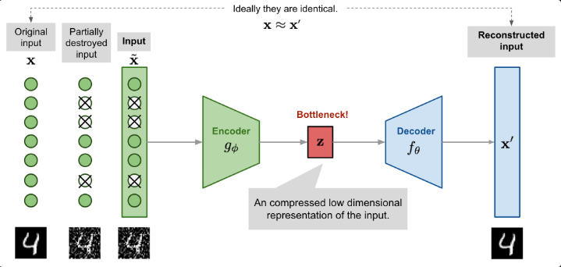
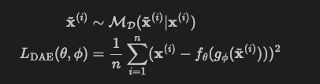

Slide 8
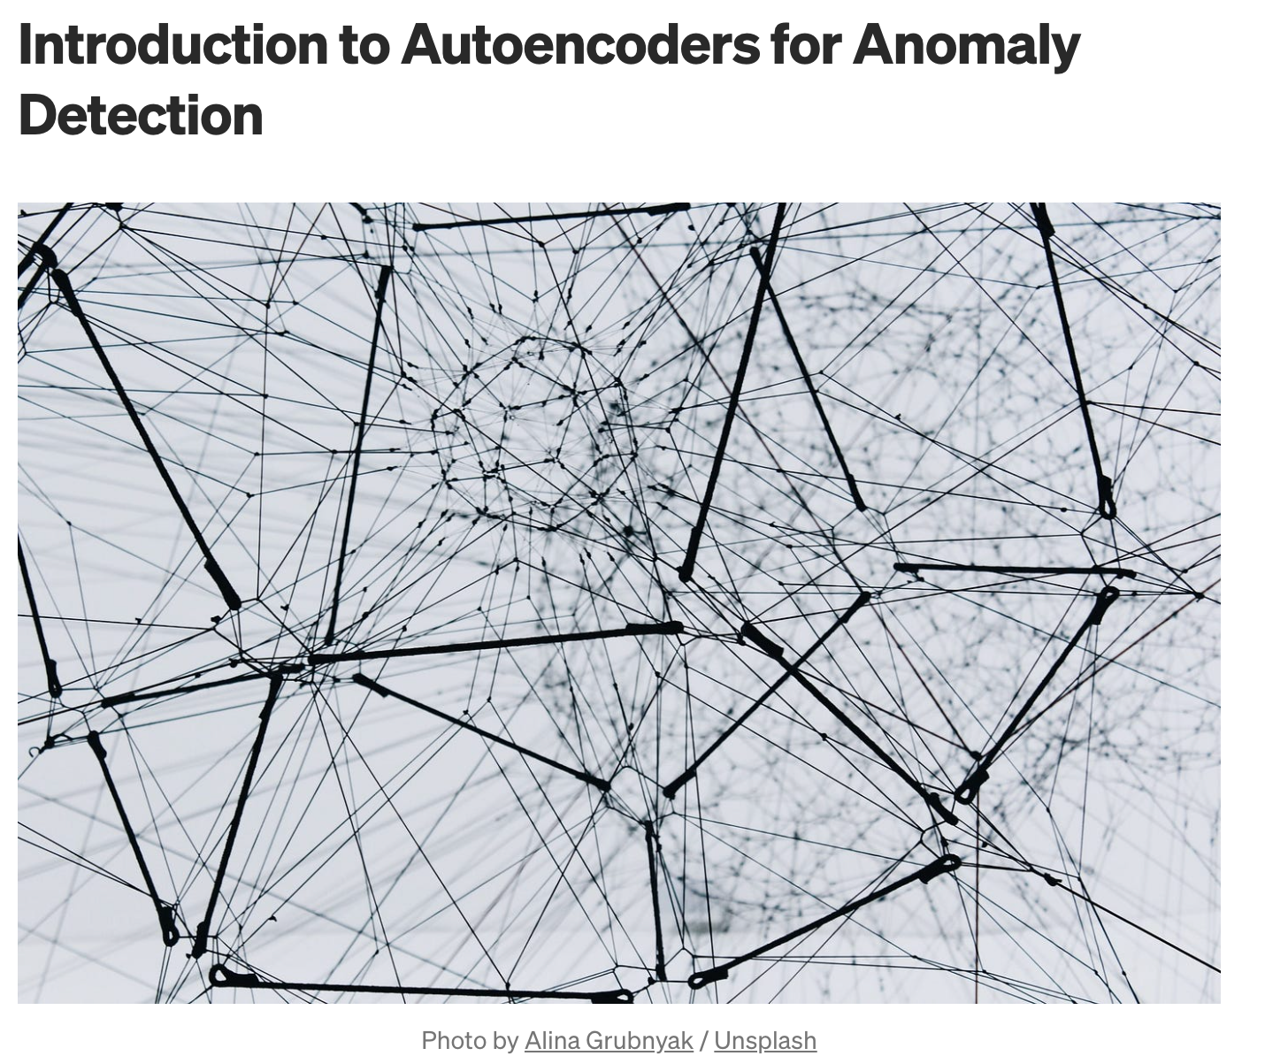

Slide 9
Introduction to Autoencoders for Anomaly Detection
https://medium.com/artificialis/introduction-to-autoencoders-for-anomaly-detection-a9897591cc72
Outlier Detection with Local Outlier Factor (LOF)
https://medium.com/@volkanillik/outlier-detection-with-local-outlier-factor-lof-8d1e29acabb4
Handbook of Anomaly Detection with Python Outlier Detection — (12) Autoencoders
https://towardsdatascience.com/anomaly-detection-with-autoencoder-b4cdce4866a6
Time Series Anomaly Detection: The Detective’s Toolbox
https://medium.com/georgian-impact-blog/time-series-anomaly-detection-the-detectives-toolbox-9ef131dddaf9

Slide 10
Variational autoencoders

Slide 11
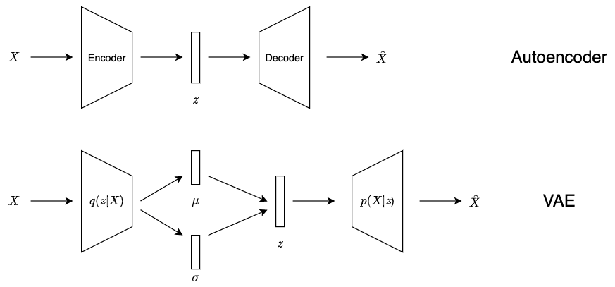

Slide 12
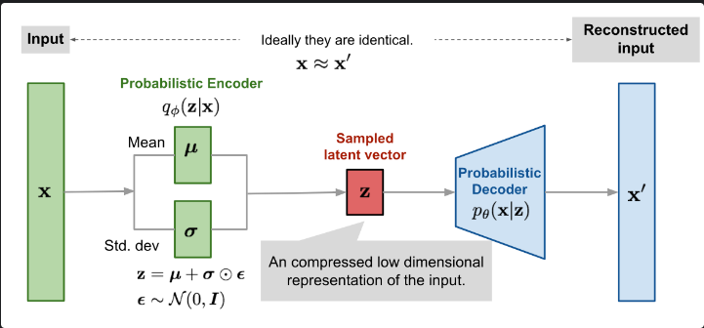

Slide 13
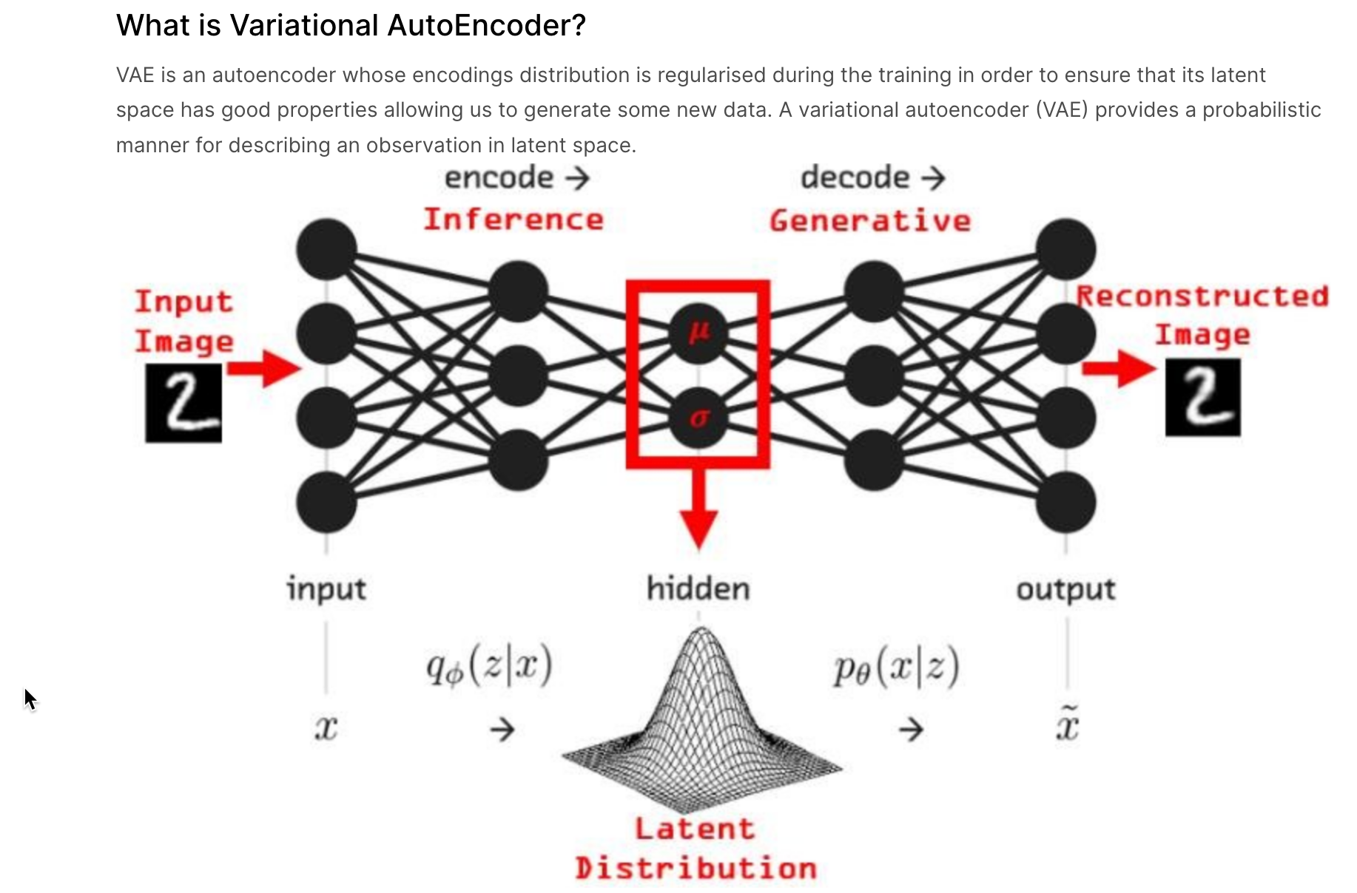

Slide 14
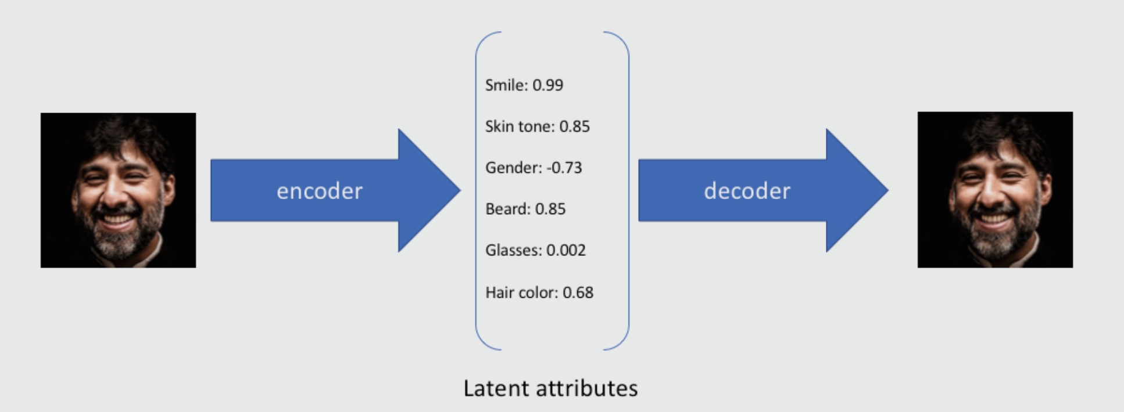
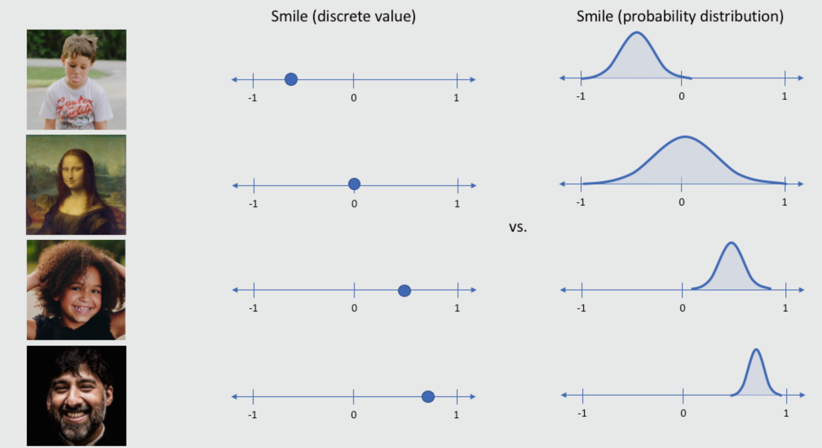

Slide 15
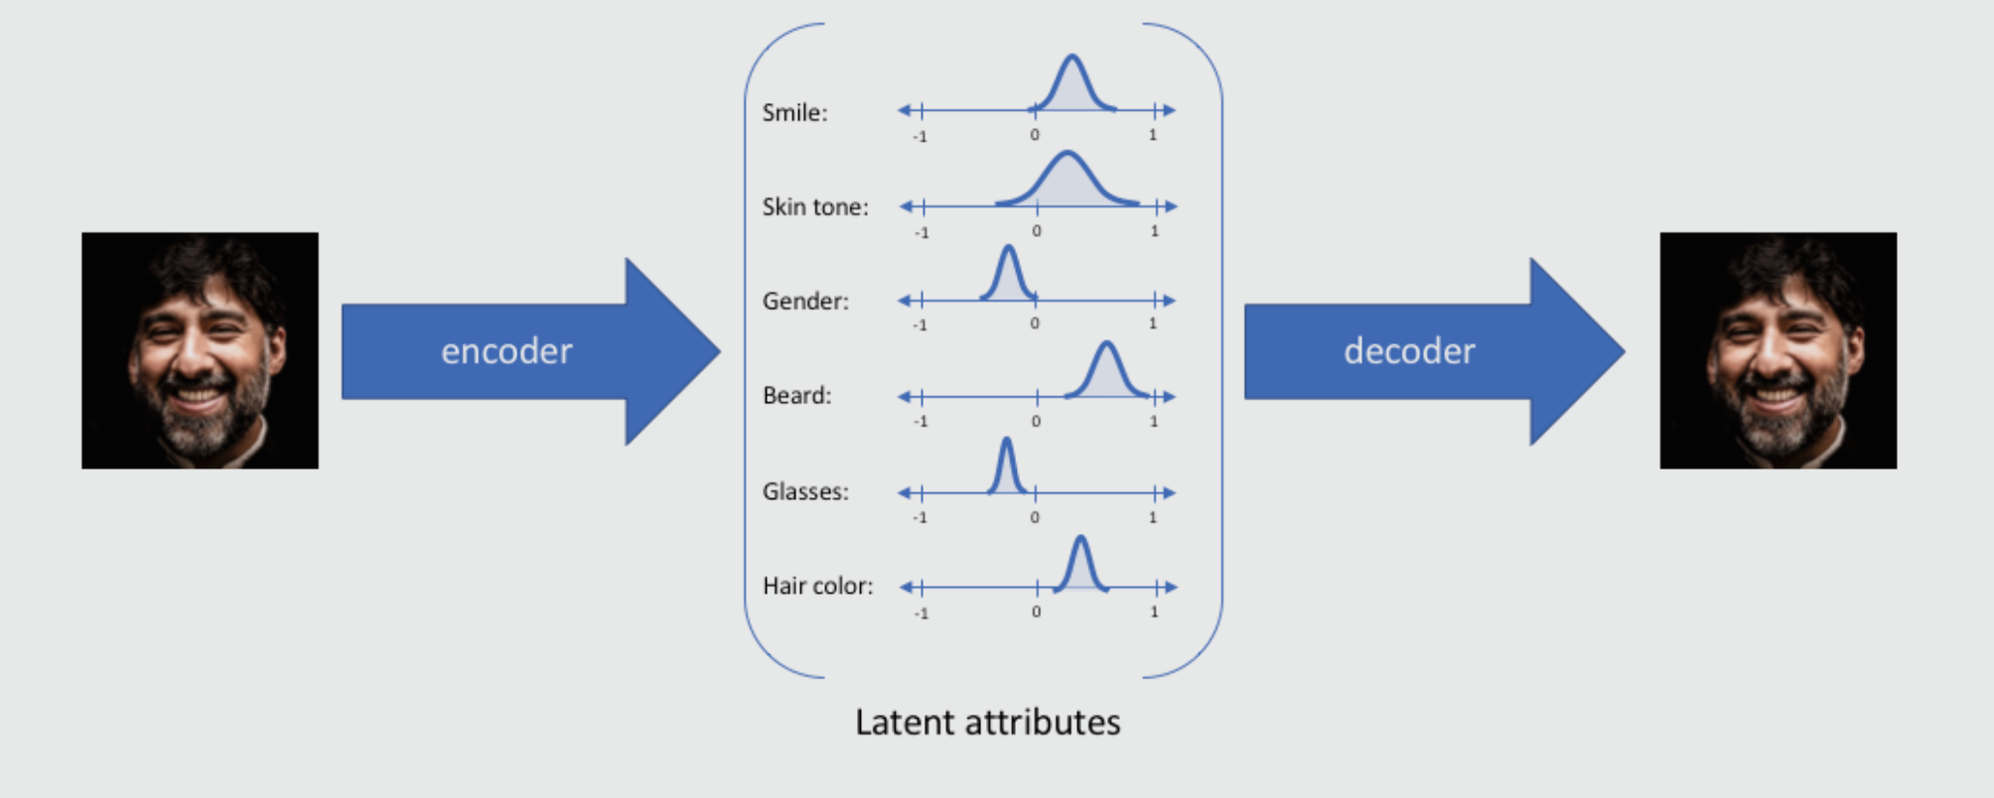
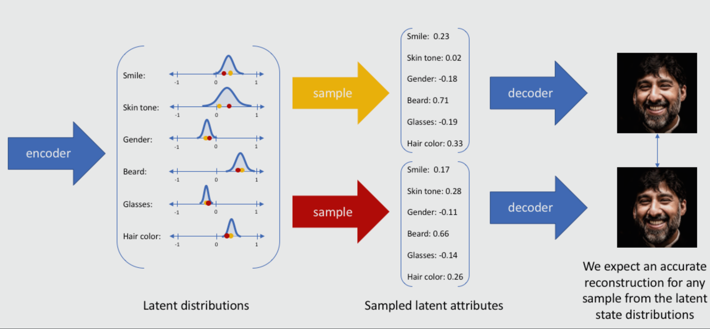

Slide 16
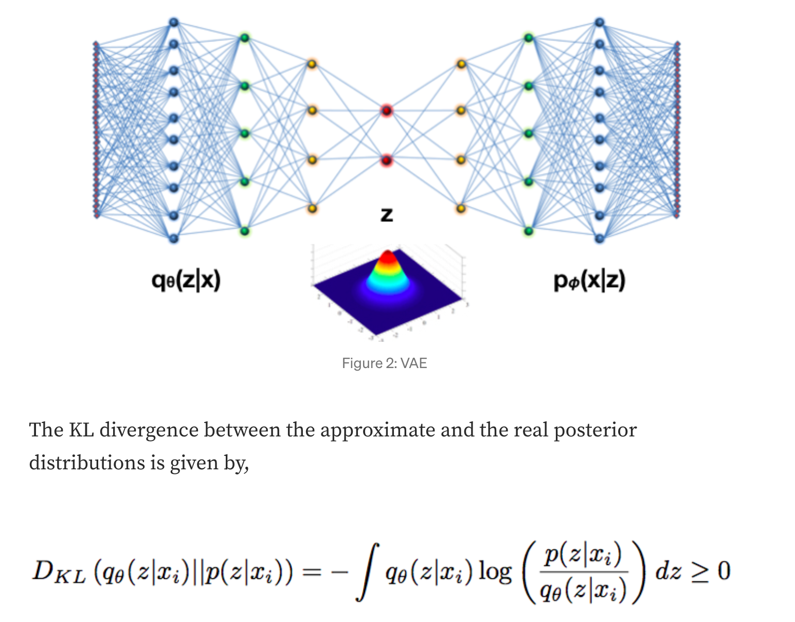
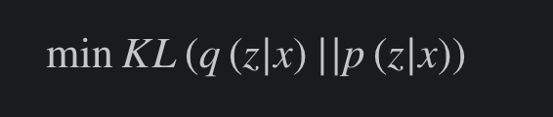
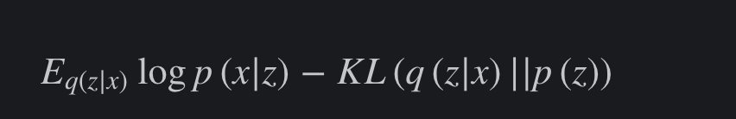
https://medium.com/dataseries/variational-autoencoder-with-pytorch-2d359cbf027b

Slide 17
Variational Autoencoder - dogs generation
https://www.kaggle.com/code/speedwagon/variational-autoencoder-dogs-generation

Slide 18
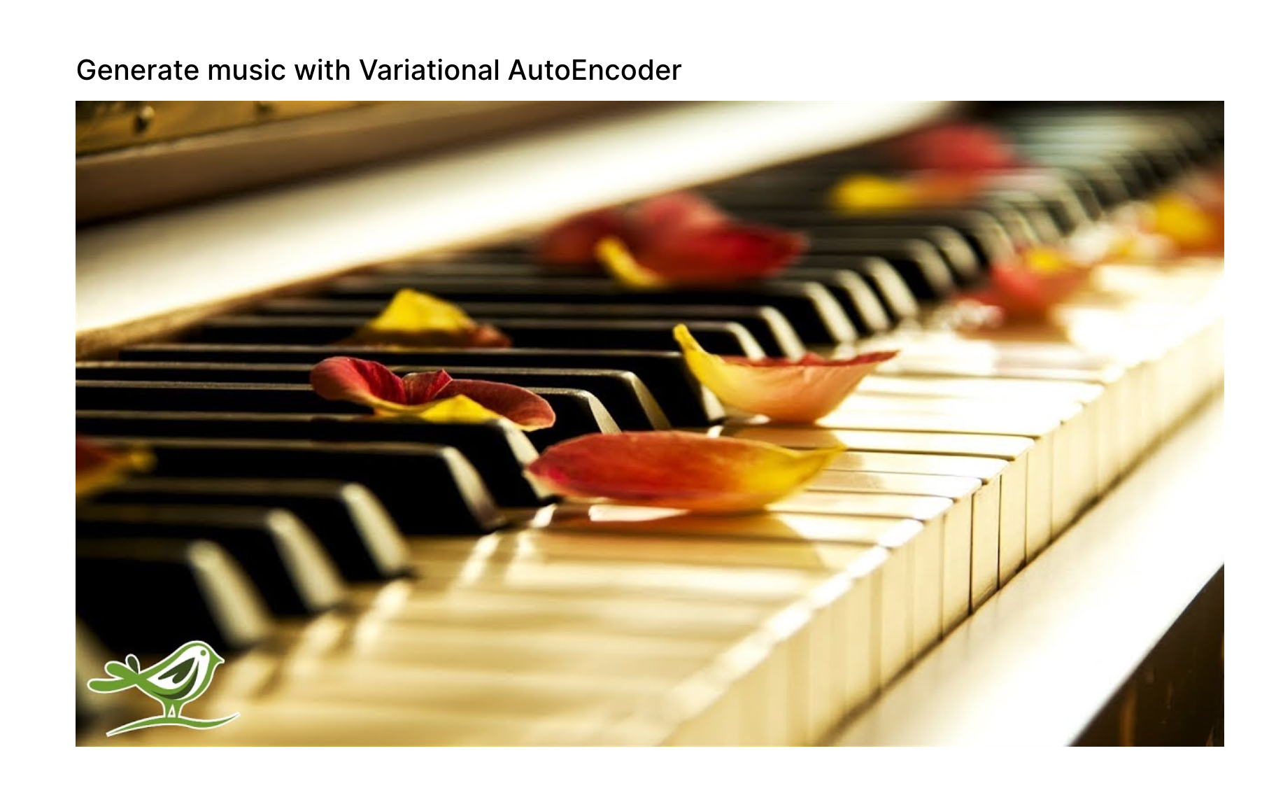
Mid term ?
https://www.kaggle.com/code/basu369victor/generate-music-with-variational-autoencoder

